Slide 1
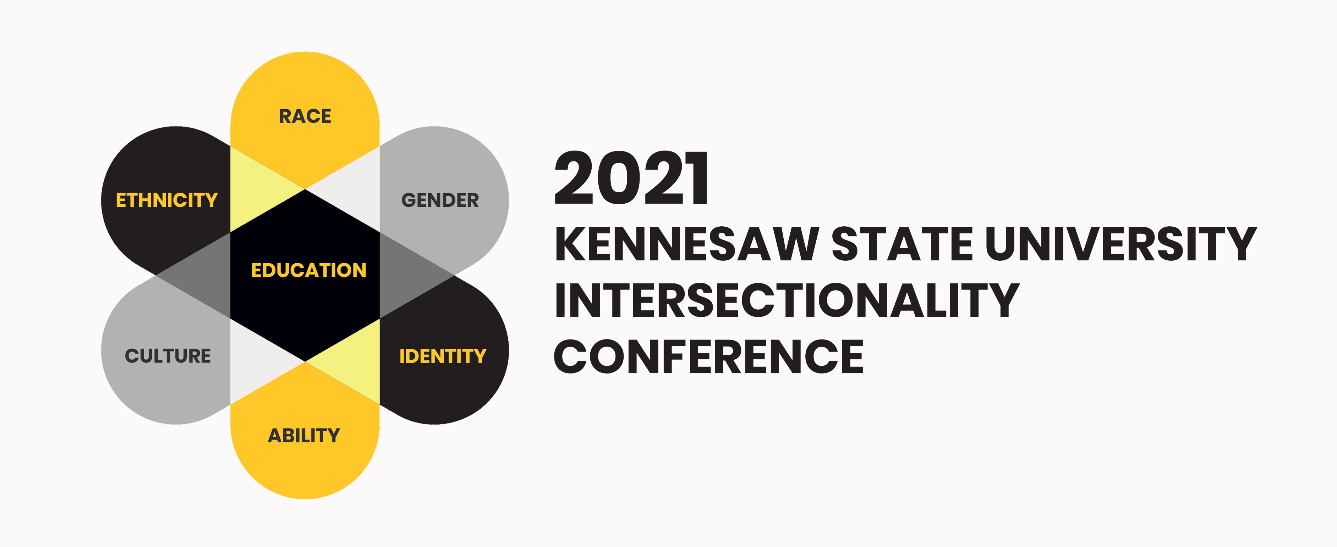
Three people
Presented by
Marcella Araujo
2 PM
Room 174

Slide 2
Three People
Marcella Araujo
Cultural and Community Centers
Notes:
Introduce yourself and any other co-facilitators and special guests. Mention campus involvement.

Slide 3
Cultural and Community Centers – Pillars and Mission
Practical and Professional Skills
Cultural Competence
Empower in Identity Exploration
Mission: Cultural and Community Centers (CCC) fosters curricular and co-curricular programs and services that link diversity, inclusion, multiculturalism, and intersection of identity to the holistic development of all KSU students.
Notes:
At the Cultural and Community Centers we explore diversity from a variety of perspectives!
The goal of CCC’s events, workshops, and other campus-wide initiatives coordinated by one of our resource centers is to foster students’ cultural competence, practical and professional skills, and empower their identity, such as being a first generation student, for example. Some of our initiatives include the AAMI (African American Male Initiative) and the CCP (Cultural Council Program).
** The KSU African American Male Initiative (AAMI) program is a minority-male enrichment program that provides academic, leadership, and professional opportunities to KSU students. AAAMI programming empowers black men to achieve academic and personal excellence so that they may become leaders in their families and communities.
Activities can include: regional leadership conferences, guest lectures, peer & professional mentorship, social outings, leadership workshops and more.
** The Cultural Council Program (CCP) at KSU consists of high achieving KSU students who are recruited to join the program and expand their knowledge of intercultural competence. As student leaders, the CCP members train hard and volunteer their time and acquired knowledge and skills to help the Cultural and Community Centers (CCC) in tabling and promotion of the department at various university-wide events. Additionally, CCP members are trained to facilitate peer-to-peer cultural competence workshops and activities. CCP members are paired with a Center coordinator based on interest and desire to learn and they assist the Center Coordinators in the planning, coordination, and execution of the various Heritage Months and Weeks that the CCC celebrates. CCP members are pivotal in assisting in the planning, execution, and promotion of CCC's campus-wide events, such as the Diversity Week, Mosaic Celebration, and more!

Slide 4
Cultural and Community Centers (CCC)
Cultural Awareness Resource Center (CARC)
STA 263 - carcksu
Race, Ethnicity, Ancestry, and Heritage
LGBTQ Resource Center
STA 253 - LGBTQKSU Sexual Orientation and Gender Identity
Global Village (GV)
STA 255 - ksu_gv
Internationalism and Global Learning
Women’s Resource Center (WRC) – STA 164 - ksu_wrc
Gender Equality and Interpersonal Violence Prevention
CCC_KSU
ccc.kennesaw.edu
ccc@kennesaw.edu
Notes:
About our resource centers – There are 4 of them. (similarities/differences)

Slide 5
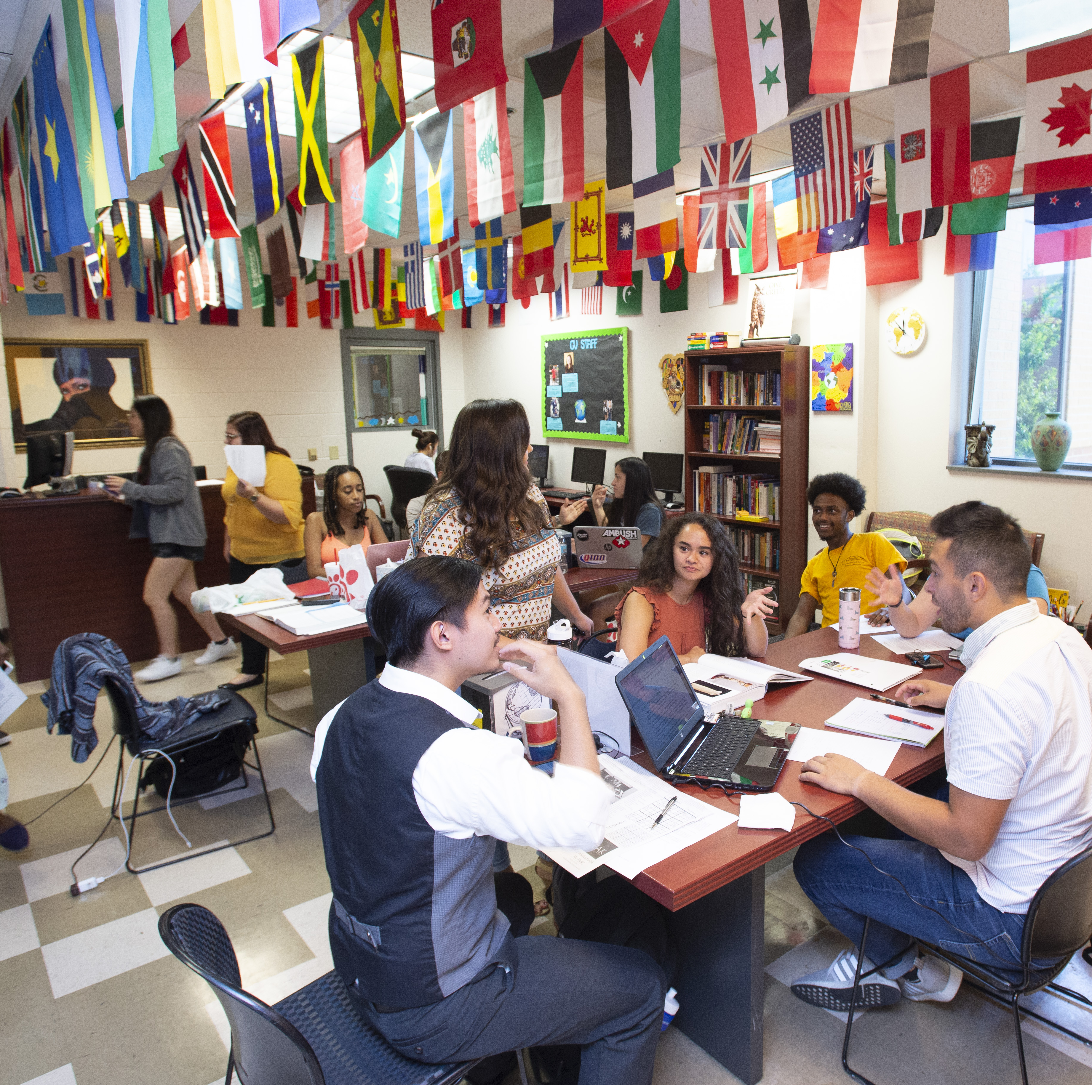
Global Village (GV) STA 255 – ksu_gv
Promote international awareness and global learning.
Opportunities for cross-cultural engagement between international and domestic KSU students.
Leadership and cultural competence development opportunities.
Advocacy, guidance, out-of-class support.
Notes:
Carmichael Student Center, Kennesaw Campus
The Global Village promotes global learning and understanding by providing programs and services that focus on intentional interaction between international and domestic KSU students, resulting in increased meaningful and impactful social and intercultural contacts, and the opportunity for all students to explore the ways in which internationalization and global learning affect and intersect with various other identities that students have.
The GV also provides students with leadership and cultural competence development opportunities, advocacy, guidance, out-of-class support in the form of academic intervention and educational programs and events, weekly workshops and discussions, networking and developing on- and off-campus partnerships, and personalized assistance.

Slide 6
Three People
Activity Agreements:
The Vegas Rule…
Judgement is out the door.
Wokeness too – hang your woke hats at the coat rack.
Participate!
If you have done it before, be a good team member.
Notes:
Activity agreements – modify the Vegas rule to: “all the vulnerabilities and personal stories that are shared will remain in the confines of this safe space we are creating, and all of the learning we can and will take with us.”
We will create a safe space, free of judgement, but also of wokeness – go to sleep.
This only works if you participate!
The last one goes without saying.

Slide 7
Three People Activity
Notes:
Introduce activity – I will introduce you to three different people by sharing with you five facts about each of them. I want you to tell me all that you know about the people based on the five facts.
Encourage students to share more as you go.

Slide 8
Person 1
Start with…
race, gender, class, age, ability status, sexual orientation, marital status, job, friendliness, location (grew up / is now at)
Use your imagination!
Government Employee
2 Master’s Degree
Speaks 3 Languages
All travel and living expenses paid
Been to 15 countries
Notes:
Change for yourself

Slide 9
Person 2
Start with…
race, gender, class, age, ability status, sexual orientation, marital status, job, friendliness, location (grew up / is now at)
Use your imagination!
Immigrant
Has multiple tattoos
Low income
Has huge family
Loves soccer
Notes:
Change for yourself

Slide 10
Person 3
Start with…
race, gender, class, age, ability status, sexual orientation, marital status, job, friendliness, location (grew up / is now at)
Use your imagination!
Crafty
Recycles
Has organic garden
Plays an instrument
Loves equestrian sports
Notes:
Change for yourself

Slide 11
Three People Debrief
How did this activity feel?
Where do we come up with things to say?
How can we work with assumptions in a way that avoids their problematic aspects?

Slide 12
Three People Debrief (continued)
Would your perspective change about them if I told you they’re all the same person?
How does the structure of this activity – showing only ‘parts’ of one person – manifest in real life situations/your experiences?
How does this activity help you shape your understanding as members of an interconnected human community?

Slide 13
Question and Answer Portion
Notes:
Thank them for their time and attention, ask for questions, answer as appropriate, and hand out evals. Collect evals at the end.

Slide 14
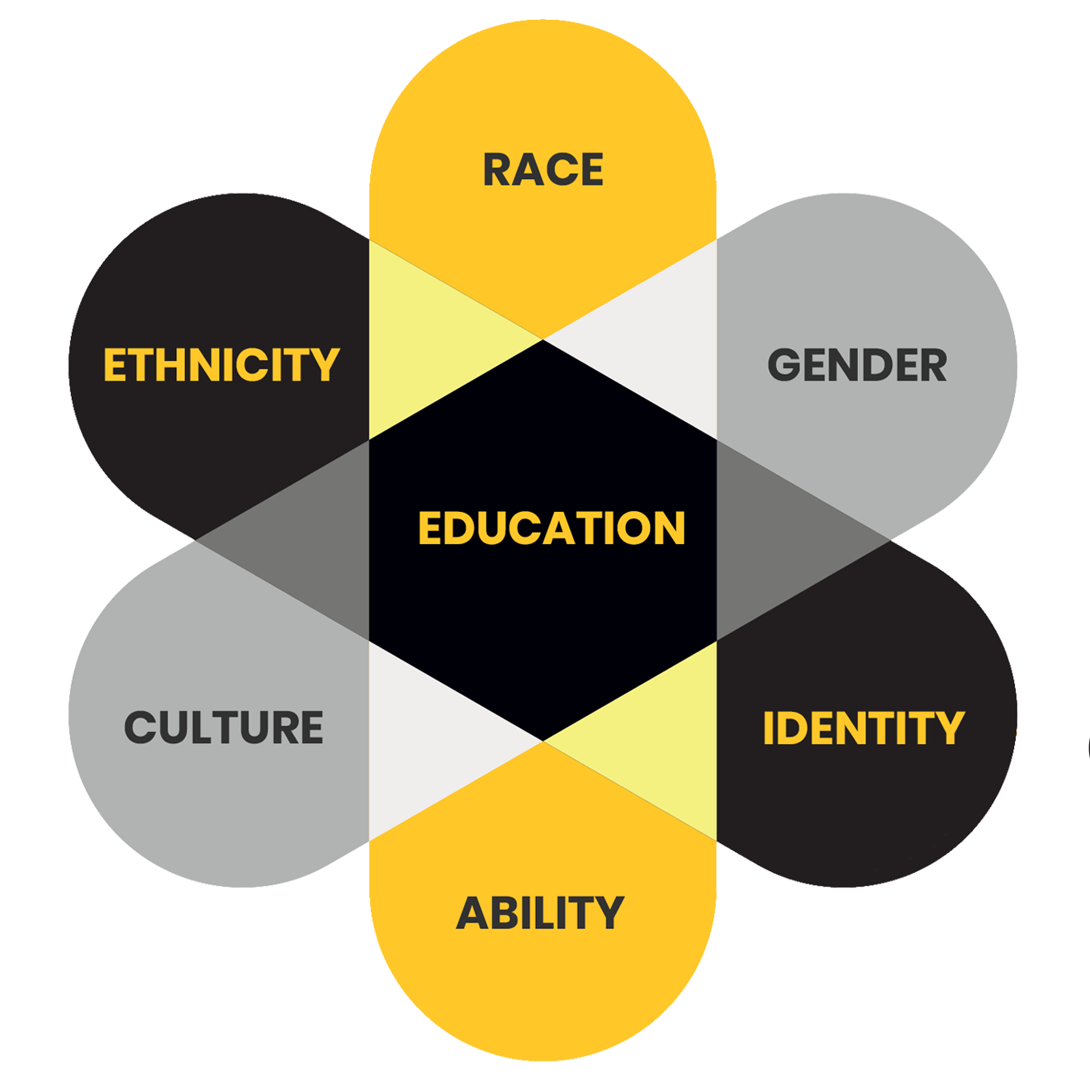
Thank you for attending!

Slide 15
Global identity panel
Presented by
Theresa Alviar-Martin, Marcella Araujo, & Kathryn Gaylord-Miles
3 PM
Room 174

Slide 16
Global identity panel
KSU Intersectionality Conference
November 5, 2021

Slide 17
Welcome!
Theresa Alviar-Martin
International Support Faculty Fellow
Marcella Araujo
GRA, Cultural & Community Centers
Kathryn Gaylord-Miles
Director of International Student and Scholar Services
Notes:
Kathryn

Slide 18
Overview
This session will have three parts
5 minute introduction by panelists
Q&A: Audience can ask questions and respond
Final questions
Notes:
Kathryn

Slide 19
Introductions
What does a “global perspective” mean to you?
What experiences led you to develop a global perspective?
How does a global perspective influence other facets of your identity?
Notes:
Tracey quick overview

Slide 20
Question & Answer
Does having a global perspective conflict with other facets of your identity? In what way?
Does having a global identity make you less “American” or less a citizen of your home country?
Audience: Feel free to ask questions for the panelists and for others to consider!
Notes:
Tracey first question
Kathryn second question

Slide 21
Final questions
In what ways has a global perspective informed your experiences as a member of the KSU community?
How can the KSU community further develop its global mindset?
How can we as individuals help bring these ideas to fruition?
Notes:
Tracey & Kathryn alternate questions, Kathryn wraps up session

Slide 22
Continue the Conversation
Teresa ALVIAR-MARTIN
Talviar@kennesaw.edu
Marcella ARAUJO
Maraujo9@students.kennesaw.edu
Kathryn GAYLORD-MILES
Kgaylor3@kennesaw.edu
Notes:
Kathryn to wrap up session

Slide 23
Thank you for attending!

